Slide 1

HIRING PROCESS ANALYTICS
~ ARYAN AUDITTO

Slide 2
PROJECT DESCRIPTION :
The project aims to analyze the hiring process, average salary, class intervals for salary, proportion of people working in different departments, and representation of different post tiers in a company. The dataset is used to gather the required information and perform using Microsoft Excel
Opened the dataset containing information about the individuals hired, including their gender, salary, department, and post tier in Microsoft Excel.
After analyzing the dataset , calculated the number of males and females hired in the organization.
Summed up the salaries of the selected group of employees.
Defined suitable intervals to group the salary data.
Used various charts and graphs such as pie charts, bar graphs, and others to represent the proportion of people working in different departments and the distribution of post tiers.
Saved the file in CSV format.
APPROACH :
TECH-STACK USED :
To complete the project, used tools such as Excel to perform data analysis, create charts and graphs, along with PowerPoint to generate the report.

Slide 3
INSIGHTS :
Throughout the project, gained insights into various aspects of the data, including gender diversity in hiring, the average salary offered, salary distribution across class intervals, departmental proportions, and post tier representation. These insights helped in order to identify trends, areas for improvement, and potential opportunities for the organization.
RESULTS :

Slide 4
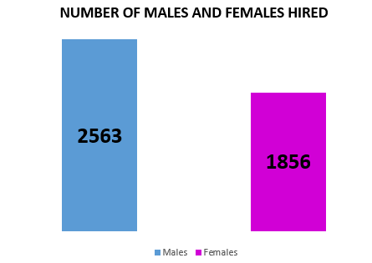
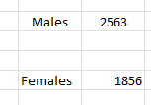
1. How many males and females are Hired ?

Slide 5
2. What is the average salary offered in this company ?

Slide 6
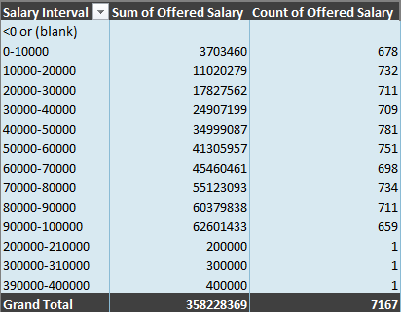
3. Draw the class intervals for salary in the company

Slide 7
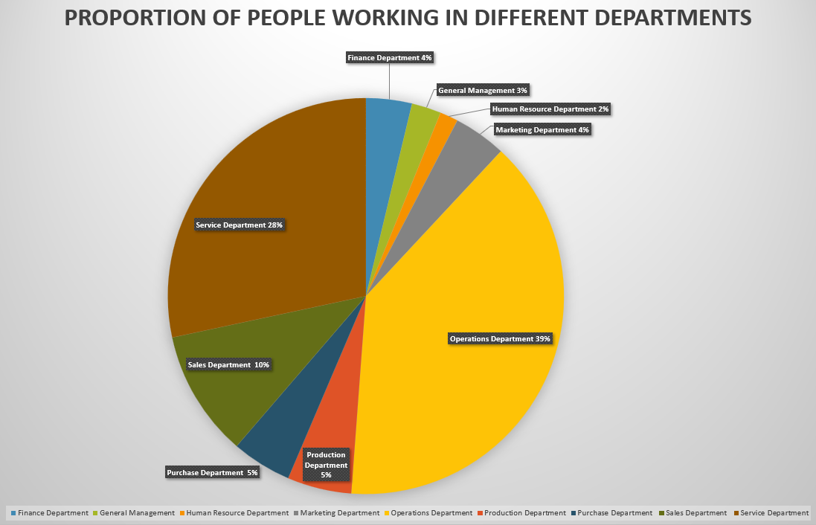
4. Draw Pie Chart / Bar Graph ( or any other graph ) to show proportion of people working different department

Slide 8
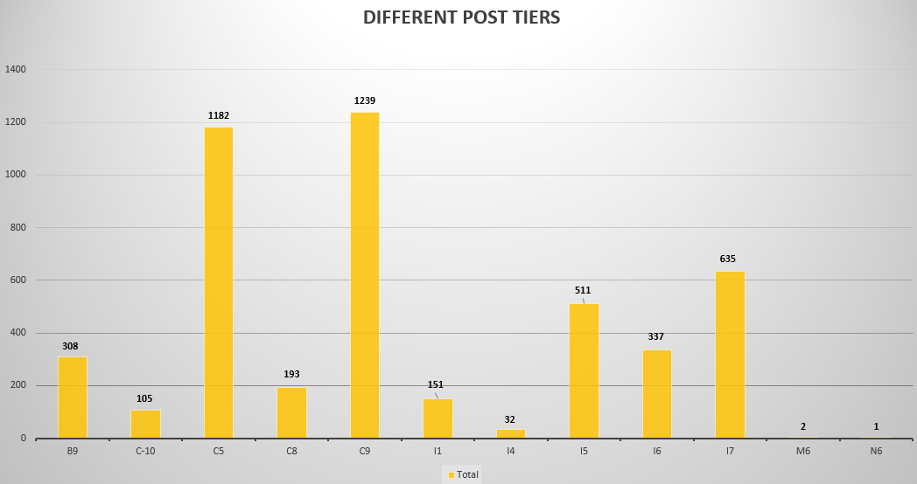
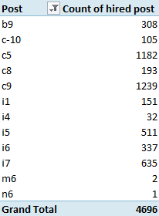
5. Represent different post tiers using chart/graph

Slide 9
THANKYOU !

